Slide 1


Are We
Student Ready?
Creating The Conditions For True Institutional Effectiveness in Student Success
Ohio Association of Community Colleges
Friday, April 27, 2017
Dr. Michael A. Baston
Vice President for Student Affairs & Associate Provost
LaGuardia Community College

Slide 2
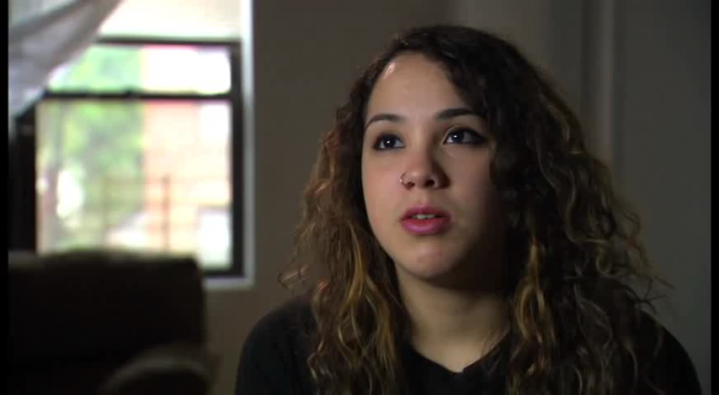
Becoming A Student Ready College
Notes:
Layla earned bachelor’s and master’s degrees from NYU, and is now teaching high-school physics. Her journey began 5 years ago. The education of today and tomorrow looks marked different from what she experienced. She experienced an approach where she had structure and support that could be best characterized as high touch and low tech. We are in the midst of the learner revolution, which will continue to be more high tech, and the high touch we’ve come to know will be quite different. The world of work as we know it is also changing.
At 16 Layla dropped out of Aviation High School where she was studying to be an airplane mechanic when she became pregnant. Her parents put her out of the family home and she went to live with the baby’s father.
Layla and so many students like her can make it but colleges must develop the collective will and collaborative strategy to make it happen.

Slide 3
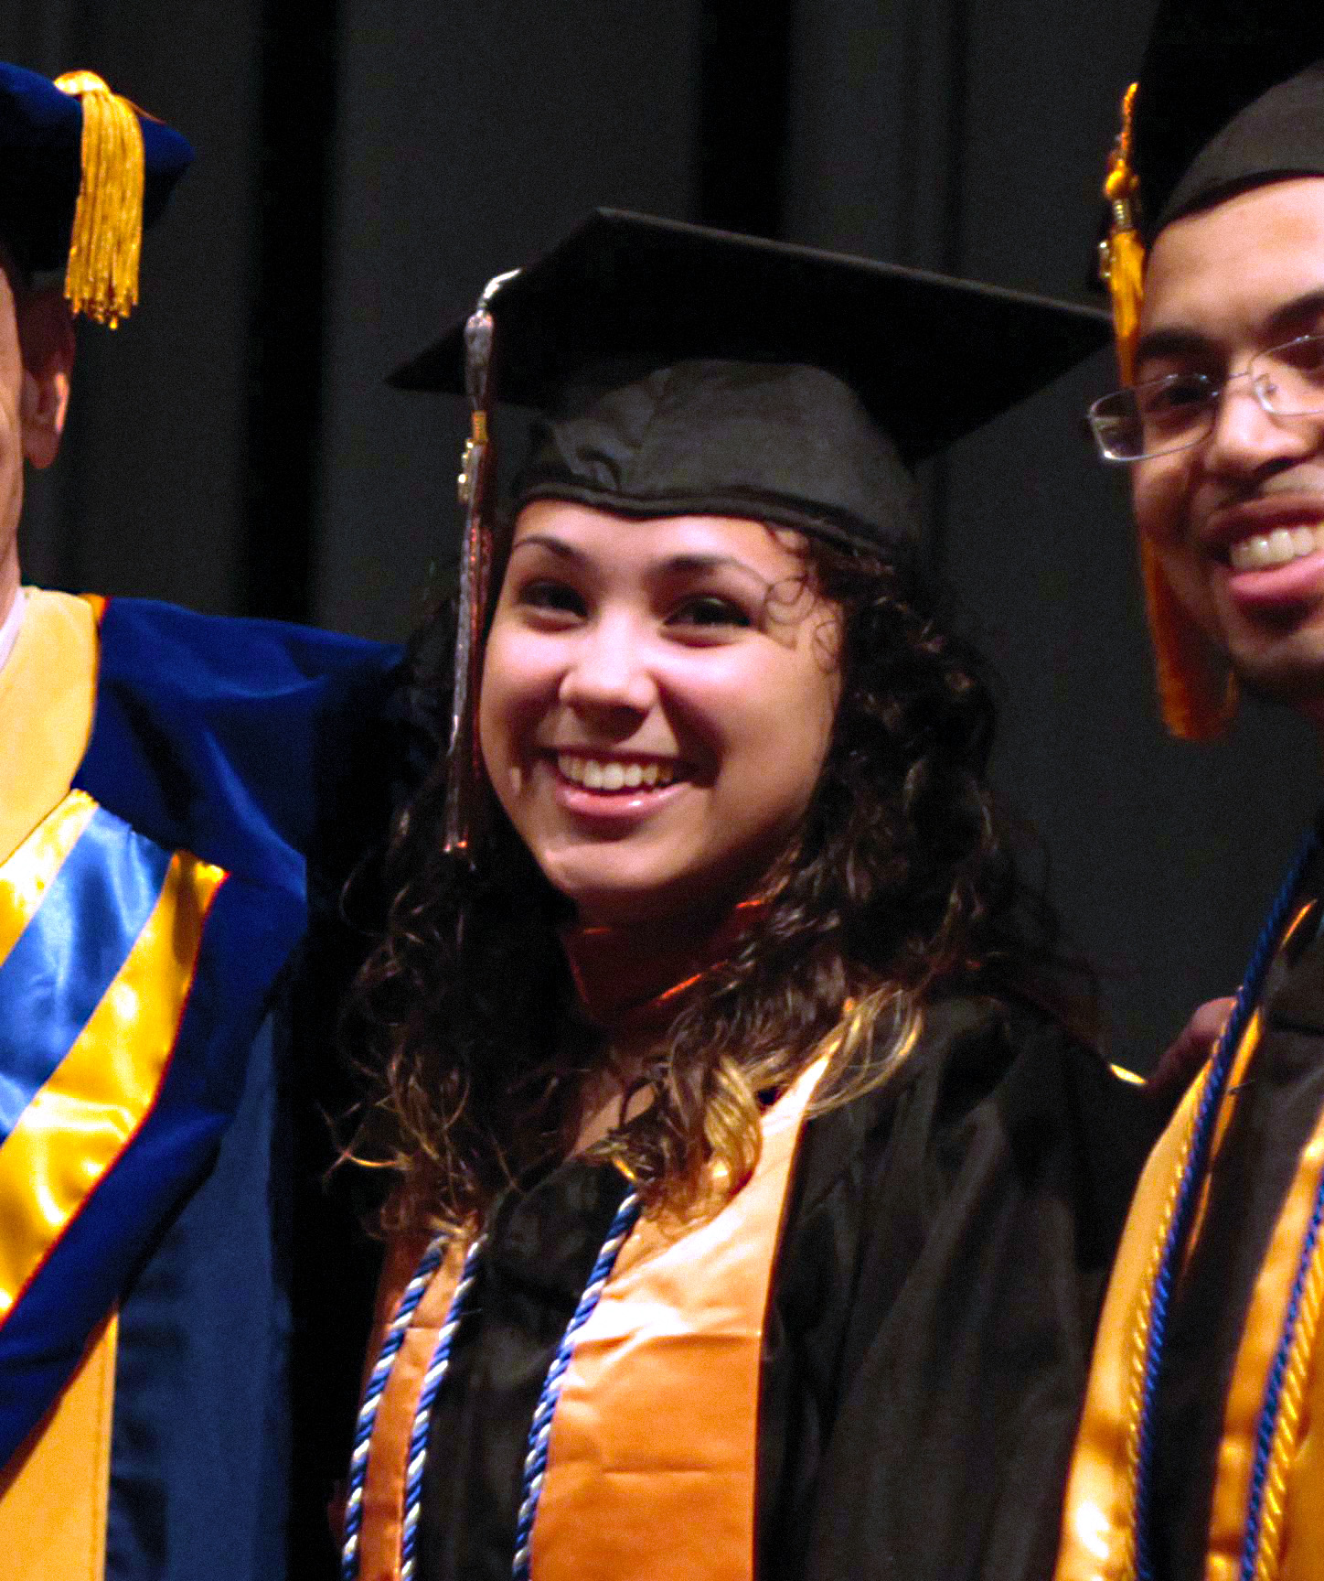
Our Students: Our Real Success Story
Layla Quiñonez
Layla enrolled in LaGuardia’s GED program.
She finished the program with the highest GED score in the state that year.
We encouraged her to continue her studies and with the financial support of public benefits and programs like state based aid and Pell and scholarships.
She excelled, joined Phi Theta Kappa Honors Society at LaGuardia.
Graduated with a 4.0, earned bachelor’s and master’s degrees from NYU and is now teaching high-school physics.
Notes:
Layla earned bachelor’s and master’s degrees from NYU, and is now teaching high-school physics. Her journey began 5 years ago. The education of today and tomorrow looks marked different from what she experienced. She experienced an approach where she had structure and support that could be best characterized as high touch and low tech. We are in the midst of the learner revolution, which will continue to be more high tech, and the high touch we’ve come to know will be quite different. The world of work as we know it is also changing.
At 16 Layla dropped out of Aviation High School where she was studying to be an airplane mechanic when she became pregnant. Her parents put her out of the family home and she went to live with the baby’s father.
Layla and so many students like her can make it but colleges must develop the collective will and collaborative strategy to make it happen.

Slide 4

Becoming A Student Ready College
A student-ready college has been defined as one that strategically and holistically advances student success, and works tirelessly to educate all students for civic and economic participation in a global, interconnected society.

Slide 5
6 Factors That Contribute To Being Student Ready
Directed
Focused
Nurtured
Engaged
Connected
Valued
Source: Student Support (Re)defined – The RP Group

Slide 6
Directed
6 Factors That Contribute To Being Student Ready
Students have a goal and know how to achieve it.
Focused
Students Stay on track – keeping their eyes on the prize
Notes:
Directed: Students have a goal and know how to achieve it.
Focused: Students Stay on track – keeping their eyes on the prize

Slide 7
Nurtured
6 Factors That Contribute To Being Student Ready
Students feel somebody wants and helps them to succeed.
Valued
Students’ skills, talents, abilities and experiences are recognized; they have opportunities to contribute on campus and feel their contributions are appreciated.
Notes:
Nurtured: Students feel somebody wants and helps them to succeed.
Valued: Students’ skills, talents, abilities and experiences are recognized; they have opportunities to contribute on campus and feel their contributions are appreciated.

Slide 8
Connected
6 Factors That Contribute To Being Student Ready
Students feel like they are a part of the college community.
Engaged
Students actively participate in class and extracurricular activities.
Notes:
Connected: Students feel like they are a part of the college community.
Engaged: Students actively participate in class and extracurricular activities.

Slide 9
Temperature Check
Supporting Student Success Institutional Self-Assessment
Page 2 of the workbook

Slide 10
Odds Against Them

Slide 11
What We Know: Tackling The Hierarchy of Needs
Applying an adapted Maslow’s Hierachy of needs for community college students is necessary to determine how to the institution will marshal resources to support students:
All of the needs must be considered when supporting community college students

Slide 12
What We Know: Tackling The Hierarchy of Needs
Persistence rates, most notably at community colleges, are affected by the following factors:
Students are often first generation college students
Students often encounter English as a second language
Students often work more than 20 hours a week
Students take care of children or relatives as the primary caregiver
Students may have only completed remedial courses

Slide 13
What We Know: Tackling The Hierarchy of Needs
Campuses that want students to be able to build momentum must:
Focus on students basic needs first
(food, clothing, shelter, travel, etc.)
Ensure the academic support structure is in place to assist them.
Help students build campus connections so that being a member of the community is their status quo.

Slide 14
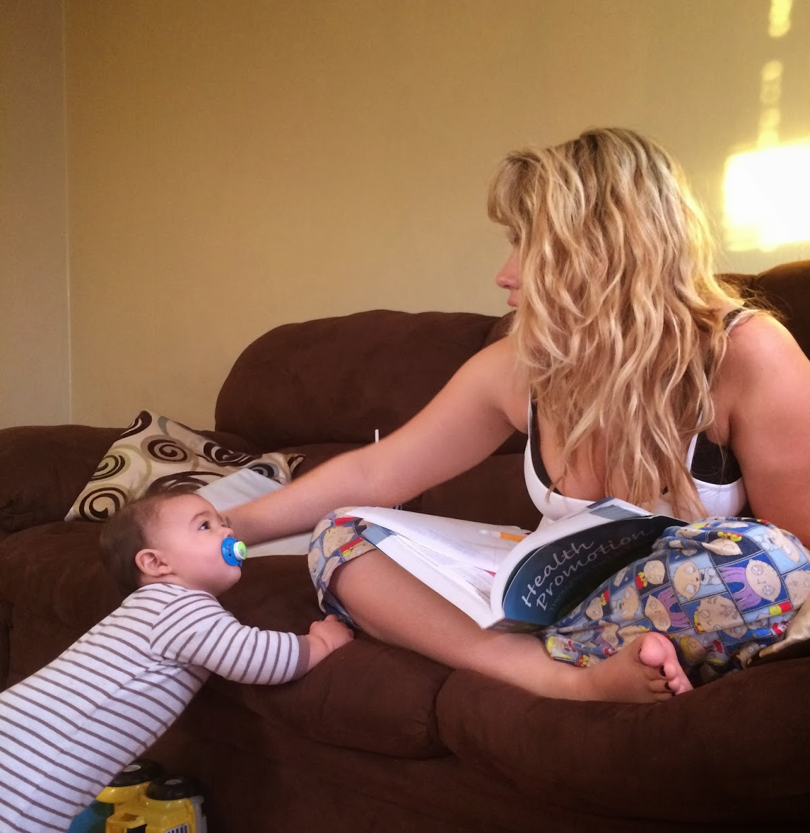
What We Know: Psychological Factors
Non-academic lives status quo
For many students their non-academic lives are status quo. Students who are used to a set of life circumstances that is much different from being in college may be driven away from school because it represents a painful and costly break from the status quo.

Slide 15

What We Know: Psychological Factors
Lack of student identity
Students that have not connected to the campus may not feel like a member of the campus community. This amplifies the status quo of non-academic life and therefore leaving is easier because the student has not been acculturated.

Slide 16

What We Know: Psychological Factors
Hassles and negative feedback
Reducing the hassles in the path of student who wished to register, pay bills, get tutoring or advising support or address other business related functions at the college without the run around and improving the tone of communications would help students feel like they belonged, were supported and an important part of the community.

Slide 17
What We Think The Enrollment Process Is
Notes:
Administrators think enrollment is a simple process. Apply. Get Financial Aid. Take Placement Tests. Get Advised. Register. Go to Orientation. Start the first day of classes.

Slide 18
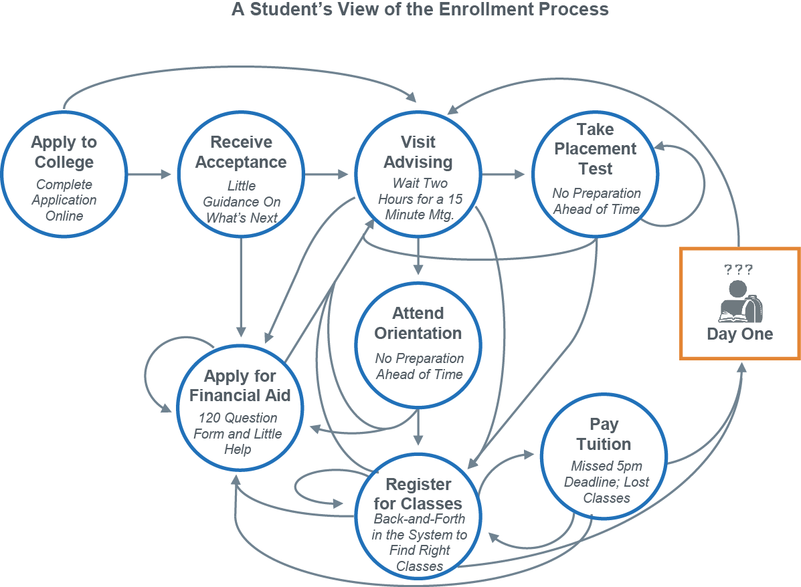
The Student Perspective

Slide 19
It’s Time To Change
Supporting Student Success Institutional Self-Assessment

Slide 20
Entire Student Pathway
CONNECTION
From interest to application
ENTRY
From entry to passing gatekeeper courses
PROGRESS
From program entry to completion of program requirements
COMPLETION
Completion of credential of value for further education and labor market advancement
Notes:
Connection- Support services should help students gain clarity about their academic and career goals and should make clear how the completion of particular course pathways will help them achieve these goals. This increased clarity should in turn strengthen students’ commitment to achieving their higher education goals.
Entry-Support activities should help students develop college-readiness competencies such as time management skills and should help them understand when, how, and where to access important college services, such as financial aid advising.
Progress-Student support activities should promote sustained and meaningful interactions between students and their professors, advisors, and classmates so that the students can develop strong college-based relationships.
Completion-Support services can help students overcome obstacles in their daily lives that, if left unaddressed, could become large enough to stymie progress toward a degree. For example, offering on-site daycare would help minimize the conflict between family and school, particularly for female students

Slide 21
Guided Pathways College
Clear roadmaps to student goals
Intake redesigned as an on-ramp
Students Progress
closely tracked
Learning outcomes assessments aligned across programs
Churning
Early Transfer
Completion
Excess Credits
Time to Degree
Skill Building

Slide 22
4 Big Ideas For Redesign
1
Mapping paths to student end goals
2
Helping students get on a path
3
Keeping students on a path
4
Ensuring that students are learning

Slide 23
Reflections on The 4 Big Ideas For Redesign
Page 3 of the workbook
Where have we made the most progress?
Where do we need the most help?
What is the general mood regarding
Guided Pathways on campus?
What’s the best case for change?

Slide 24
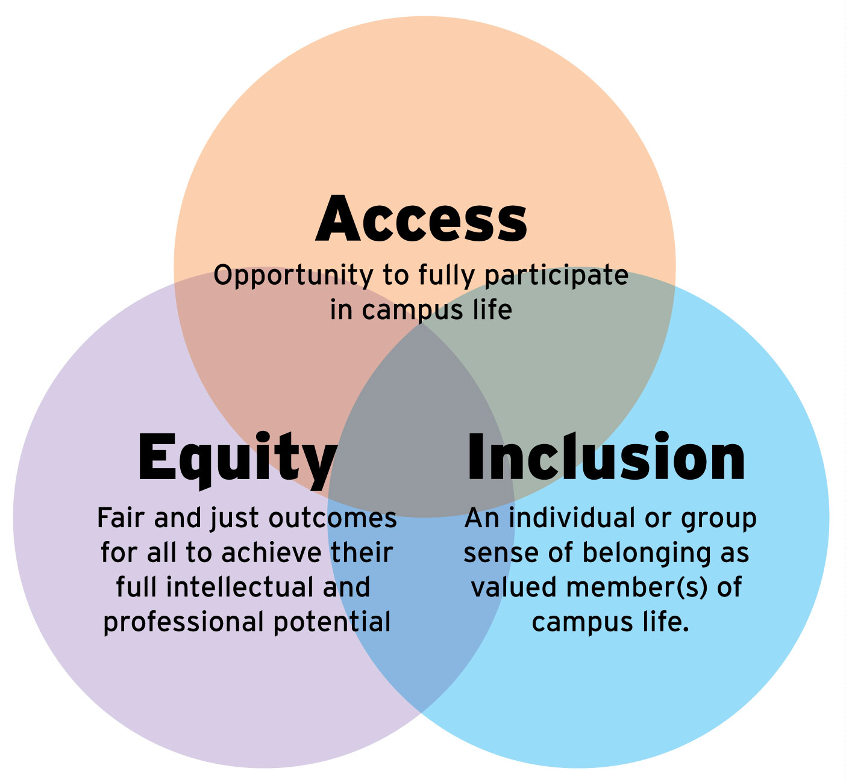
Striving For Inclusive Excellence
Being Student Ready Means Having A Commitment To Inclusive Excellence

Slide 25

What Inclusive Excellence Is NOT:
Affirmative Action
Equal Employment Opportunity
Altruism
Redress
Tolerance
Quality Adverse
Non-meritorious

Slide 26
What Inclusive Excellence IS:
Inclusion is the active, intentional, and ongoing engagement with diversity - in people, in the curriculum, in the co-curriculum, and in communities. Inclusive Excellence is a level of institutional success that can only be realized in diverse communities where all constituencies have equitable opportunities to succeed.
See: Williams, D. A., Berger, J. B., & McClendon, S. A. (2005). Toward a model of inclusive excellence and change in postsecondary institutions. Washington, DC: Association of American Colleges and Universities.

Slide 27
Equity Matters
Equity redirects resources to the pathways with the greatest need to fix barriers and intentionally provide support.
Source: Center For Urban Education

Slide 28
Center For Urban Education: Inquiry Model
Data
Identify Inequities
Goal Setting
Source: Center For Urban Education

Slide 29
Becoming An Equity Leader
Create equity by building your capacity to:
Talk about race by naming where there are gaps by race and ethnicity and where there are no gaps.
Focus on what you can change – in the classroom. (Department & Campus)
Ground recommendations and solutions in data letter about yourself and your unique context.
Understand that you are doing the “Good” even when it feels uncomfortable.
Source: Center For Urban Education

Slide 30
Reflections on Equity Leadership
Page 4 of the workbook
My goal for my campus around issues of equity are?
The most important individuals with the
power to act on my goals are…?
How are they influenced?

Slide 31
10 Ways Everyone Can Help Support Student Success
Ask students why they are in college
Help students navigate their way through the different offices, programs and services at the college
Connect students with services or resources that can help them with career exploration, goal selection and ongoing academic assistance
Have high expectations for students and hold them accountable
Ask students for feedback about their experience, including what works, what needs improvement and what’s missing
Encourage participation in out-of-class activities
Help students build peer support networks
Show students that you are proud to work at your institution and that they should be proud to be enrolled at your community college
Recognize the value of students’ talents, abilities, skills and experiences and connect them with opportunities to contribute
Communicate and demonstrate to students that you care about their success
Source: Student Support (Re)defined The RP Group

